Slide 1
Web API & Classification Model
By: Evelyn Li

Slide 2
Agenda
Subreddit selection
Models
Key features
Key Takeaways

Slide 3
Subreddit selection
Ask Men
Ask Women
Relationship Advice
Title + Self Text
Title + Self Text

Slide 4
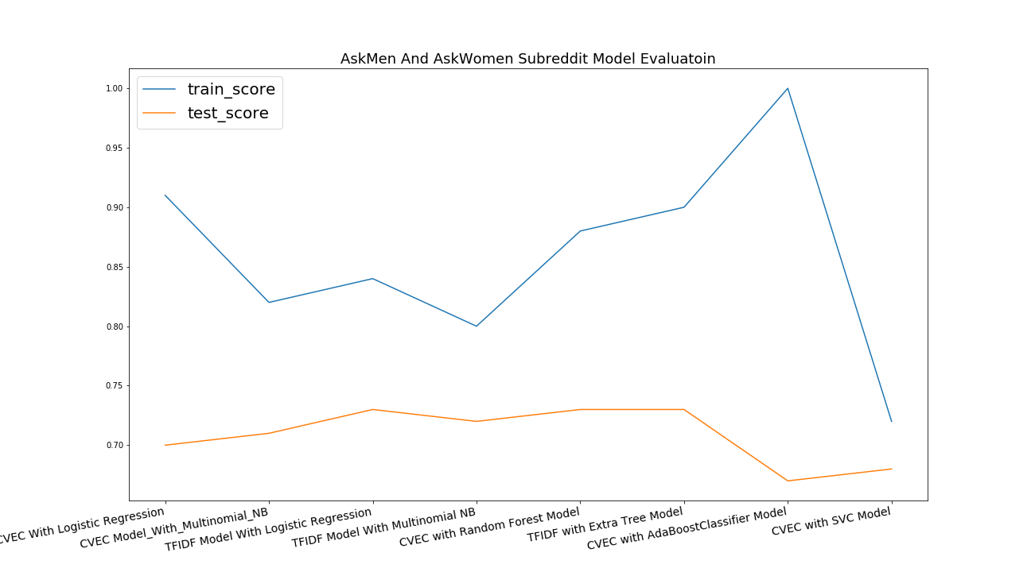
Models for Ask Men Ask Women

Slide 5
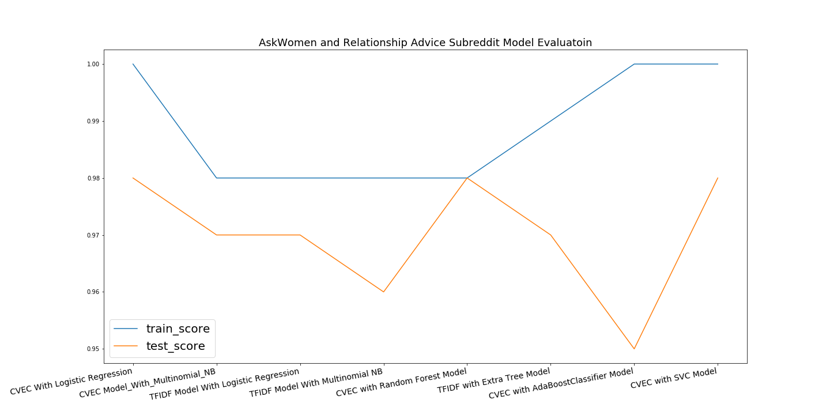
Models for Ask Women Relationship Advice

Slide 6
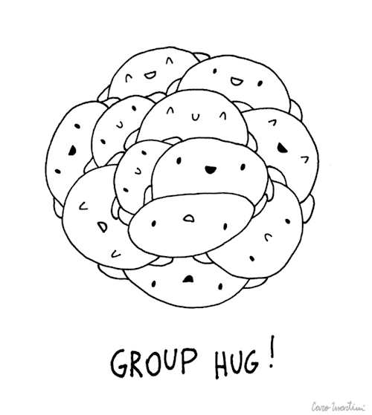
Why not combine all of them?

Slide 7
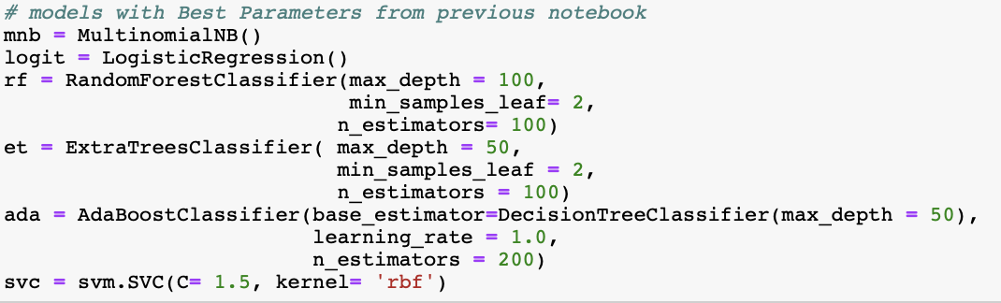
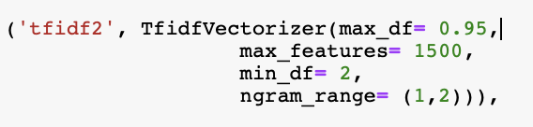
And this is the model:
About 400 Models

Slide 8
Model Evaluation
Ask Men Ask Women Dataset
Relationship Advice Ask Women Dataset
Train Score 0.92
Test Score 0.733
Train Precision = 0.88
Test Precision = 0.709
Train ROC AUC score = 0.905
Test ROC AUC score = 0.699
Train Score 0.99
Test Score 0.98
Train Precision = 1.0
Test Precision = 0.99
Train ROC AUC score = 0.98
Test ROC AUC score = 0.98

Slide 9
WHY is THIS happening?
Notes:
Why one model performs better than the other? What is this classifier doing behind the scene?
We are talking about there is a difference between content, and if two content are more similar, the model will perform better, if the content is different, then the model will perform poorly? But is this true? If that is true, what can we do about it?

Slide 10
Hypothesis: large train test score gap => More overlap in top Features SMALL train test score gap => LESS overlap in top features

Slide 11
A QUICK WALKTHROUGH OF THE STEPS
FLIP THE TARGETS
{Ask Men : 0, Ask Women :1} → {Ask Men : 1, Ask Women: 0 }
{Relationship : 0, Ask Women :1} → {Relationship: 1, Ask Women : 0 }
COLLECT THE COUNTS FROM CVEC/TFIDF
Top 100 to 500 most common words and find the % of overlap
EXTRACT COEFFICENTS OF THE MODELS
Find top100 to 500 features and find the % of overlap
Notes:
The goal of this project is really trying to achieve the most accurate prediction, and we have all these incredible models

Slide 12
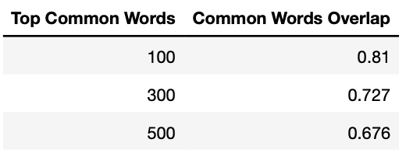
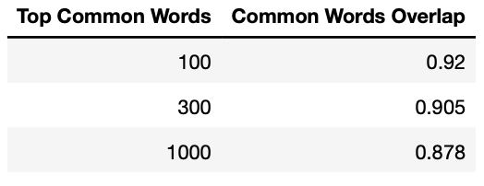
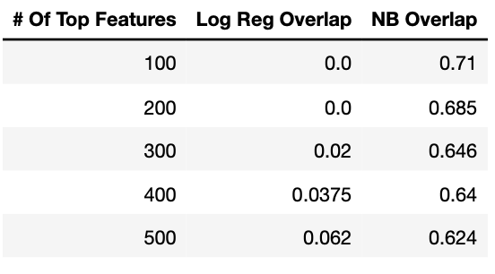
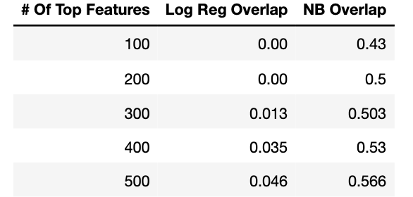
THE TRUTH IS … HYPOTHESIS is correct
Ask Men Ask Women Dataset
Relationship Advice Ask Women Dataset

Slide 13
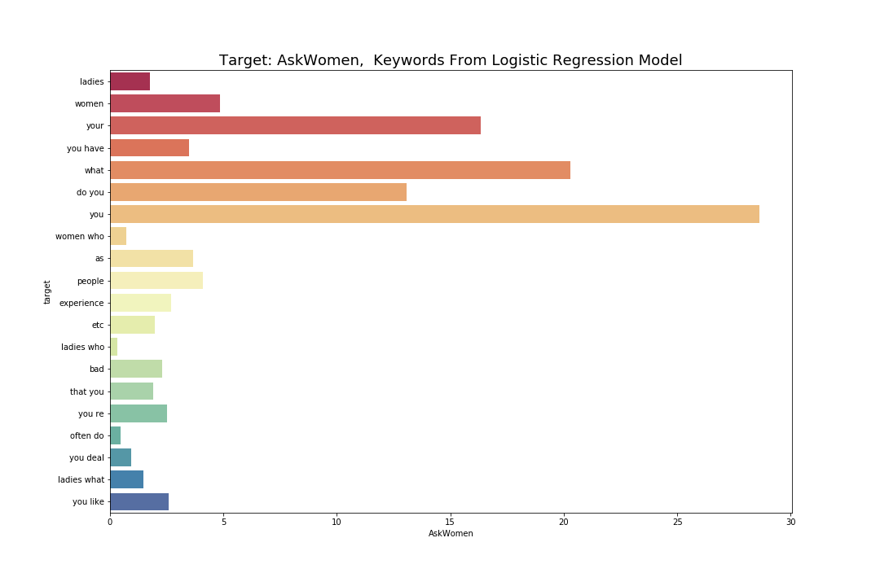
TFIDF Score
Notes:
Most significant features(keywords) to identify target is not the ones that has the most counts in the post.

Slide 14
KEY TAKEAWAYS

Slide 15
large train test score gap => More overlap in top Features SMALL train test score gap => LESS overlap in top features SOLUTION: INCREASE SIZE OF THE DATA
Notes:
Solution

Slide 16
THANK YOU

